Slide 1



SMART INDIA HACKATHON 2026
    Problem Statement ID - 26059
    Problem Statement Title - AI-Enabled Antarctic Sea-Ice,
Iceberg Trajectory, and Navigation Decision Support System
    Theme - Transportation & Logistics
    PS Category - Software
    Team ID - 143266
    Team Name - Caffeine Geeks

Slide 2


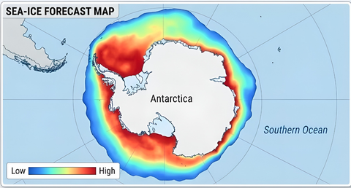




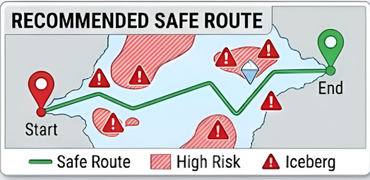


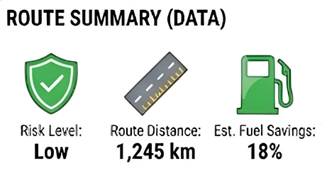

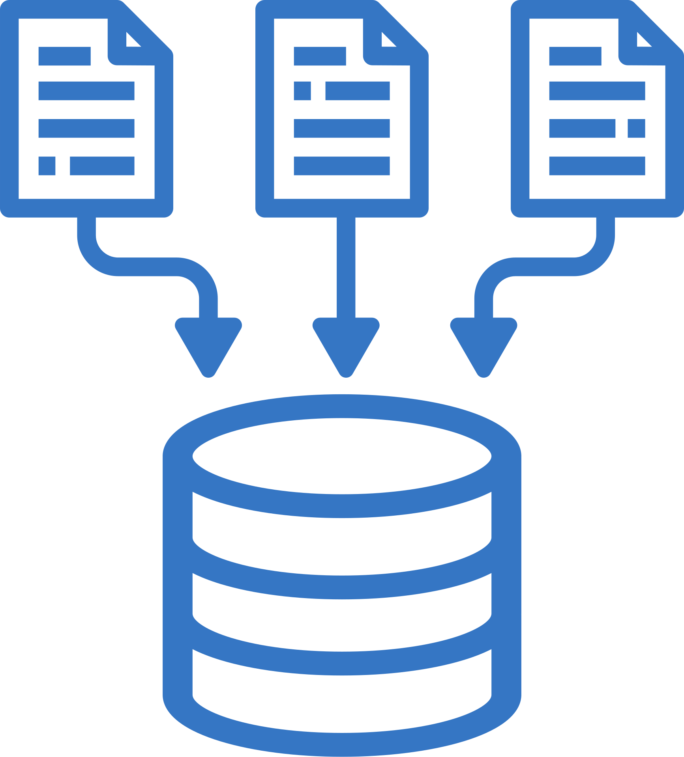





NavIce - Dhrishti
Caffeine Geeks
Proposed solution & Approach
DATA SOURCES
PREDICTED OUTPUTS
Satellite Data
(Sea-ice Concentration, SAR Imagery)
Sea-ice Forecasting
Iceberg Trajectory Prediction
Risk Assessment Engine
Route Optimization (Hazard-aware A*)
Oceanographic Data
(Currents, Temperature, Salinity)
Meteorological Data
(Wind, Pressure, Air Temperature)
Predict future sea-ice concentration maps
Predict future iceberg positions using ocean currents & wind
Identify high-risk zones (sea-ice & iceberg collision risk)
Find safest & most fuel-efficient route for vessel navigation
Historical Iceberg & Drift Data
Past trajectories,
Iceberg catalog)
SYSTEM WORKFLOW
HOW IT ADDRESSES THE PROBLEM
• Fuses satellite, oceanographic and meteorological data into one operational view.
• Forecasts future ice conditions instead of relying only on static observations.
• Predicts iceberg movement with physical constraints plus learned drift correction.
• Converts both hazards into a time-aware risk field and computes an actionable route.
Data
Collection
Data
Preprocessing
AI/ML Models
(Training & Inference)
Route
Generation
Risk Analysis
& Optimization
Key Differentiator: We do not just visualize data; we use a risk-weighted A* algorithm to output actionable turn-by-turn routing based on ML predictions.
@SIH Idea submission- Team Caffeine Geeks
2

Slide 3






















TECHNICAL APPROACH
Caffeine Geeks
FLOWCHART
SYSTEM ARCHITECTURE
AMSR2 / SSMIS
SENTINEL-1 SAR
NCPOR / OCEAN
WEATHER
Sea-ice
concentration
Ice structure /edge
Currents • SST
salinity • waves
Wind • pressure
• temperature
DATA LAYER
(Collect & Prepare Data)
ML / ANALYTICS LAYER
(Predict & Analyze)
BACKEND LAYER
(APIs & Business Logic)
FRONTEND LAYER
(Visualization & Interaction)
Satellite Data:
DATA INGESTION + PREPROCESSING
NSIDC Sea-ice Concentration, SAR, Passive Microwave
Sea-ice Forecasting:
xarray • pandas • NumPy • GDAL • Python
Time-series + CNN model predicts future ice concentration
  RESTful API (Python/Flask)
  Data Ingestion & Processing
  ML Model Inference
  Route Optimization Engine
  Serve Predictions & Results
  Data Storage (SQLite / GeoJSON Files)
FORECASTING / PREDICTION LAYER
Oceanographic Data:
Iceberg Trajectory Prediction:
  React
  Polar Map (Leaflet.js)
  Ice Concentration Heatmap
  Iceberg Markers & Trajectories
  Safe Route Visualization
  Charts & Analytics (Recharts)
  Leaflet | Recharts
Copernicus Marine Service (Currents, Temperature, Salinity)
SEA-ICE FORECASTING
ICEBERG DRIFT PREDICTION
Physics-informed drift model (Ocean Currents + Wind) + Historical patterns
ConvLSTM / spatio-temporal model
→ future concentration
grid + confidence
Physics + ML / Kalman correction
→ trajectory cone + confidence
Meteorological Data:
Route Optimization:
ERA5 Reanalysis (Wind, Pressure, Air Temperature)
A* Search (Hazard-aware) – Avoids high ice concentration & iceberg paths, optimizes fuel-efficient route
Data Storage
(SQLite / GeoJSON Files)
DYNAMIC RISK MAP
TECH STACK
Sea-ice + iceberg proximity + prediction confidence
Frontend
Backend
Data & Storage
ML / Libraries
ROUTE OPTIMIZATION
A* / Dijkstra → safest + fuel-efficient route
🚢 SAFE • FUEL-EFFICIENT • DELAY-REDUCED POLAR ROUTE
Goal:
Build an AI/ML-enabled platform that forecasts Antarctic sea-ice concentration, predicts iceberg trajectories, and recommends safe & fuel-efficient navigation routes for research vessels.
@SIH Idea submission- Team Caffeine Geeks
3

Slide 4
FEASIBILITY AND VIABILITY
Caffeine Geeks
WHY IT IS FEASIBLE
• Public / institutional satellite and ocean datasets
• Open-source Python geospatial + deep-learning stack
• Established forecasting, drift-model and pathfinding methods
• MVP can demonstrate the complete prediction → routing loop
KEY CHALLENGES
• Satellite gaps / different spatial resolutions
• Sparse Antarctic meteorological observations
• Limited labeled iceberg trajectories
• Forecast uncertainty grows with lead time
MITIGATION STRATEGY
• Multi-source data fusion to reduce observation gaps
• Physics-based fallback when ML confidence is low
• Transfer learning / augmentation using related polar data
• Confidence-aware routing penalizes uncertain high-risk cells
RESOURCES REQUIRED
    100% open-source stack. We utilize public Copernicus/Sentinel satellite data and standard Python ML/geospatial libraries (GDAL, PyTorch).
SCALABILITY
    By leveraging PostGIS spatial indexing, the system scales to handle high-resolution, continent-wide grid queries in milliseconds.
MVP PRIORITY | Ice forecast + iceberg trajectory + risk grid + A* route + interactive map
@SIH Idea submission- Team Caffeine Geeks
4

Slide 5
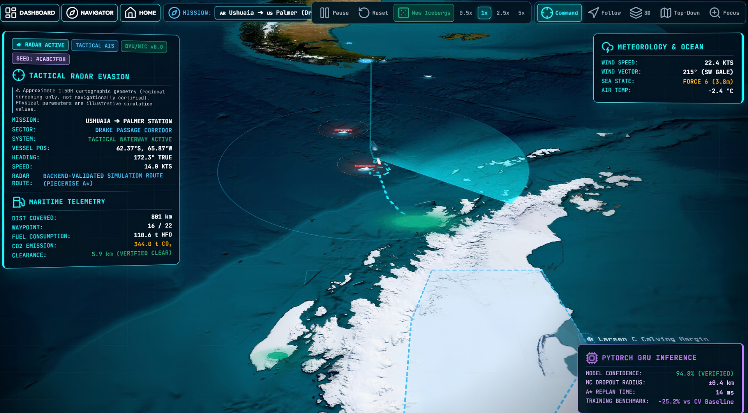
IMPACT AND BENEFITS
Caffeine Geeks
SAFETY
EFFICIENCY
RELIABILITY
TARGET USERS
• NCPOR / Indian Antarctic missions
• Research vessel crews
• Antarctic logistics & supply operations
• Polar research organizations
Earlier warning of future
ice / iceberg hazards
Avoid unnecessary detours
while controlling risk
Better route planning for
polar research missions
1. Operational Efficiency & Cost Savings
  Optimized Routing: A* finds safer, shorter routes to Maitri & Bharati.
  Fuel Savings: Avoids heavy ice and adverse conditions.
  Damage Prevention: Predicts iceberg movement to reduce collision risks.
2. Enhanced Maritime Safety
  Live Hazard Detection: Combines ConvLSTM sea-ice forecasts and GRU iceberg predictions.
  50×50 Risk Grid: Provides real-time navigation risk assessment.
  Emergency Alerts: SOS, SMS and Email alerts for critical hazards.
3. Environmental & Strategic Impact
  Protects Antarctica: Reduces collision and oil-spill risks.
  Lower Emissions: Efficient routes reduce fuel consumption and CO₂.
  Supports NCPOR: Unifies polar navigation, prediction and routing in one AI platform..
PREDICT BETTER → WARN EARLIER → ROUTE SMARTER → OPERATE SAFER
@SIH Idea submission- Team Caffeine Geeks
5

Slide 6
RESEARCH AND REFERENCES
Caffeine Geeks
VERIFIED DATA & RESEARCH REFERENCES
1. NOAA/NSIDC Sea Ice Concentration CDR v6
5. Copernicus Data Space - Sentinel-1
https://nsidc.org/data/g02202/versions/6
https://dataspace.copernicus.eu/data-collections/copernicus-sentinel-missions/sentinel-1
2. NOAA/NSIDC Near-Real-Time Sea Ice CDR v4
6. NCPOR / National Polar Data Center
https://nsidc.org/data/g10016/versions/4
https://npdc.ncpor.res.in/npdc/homepage.action
3. NASA Earthdata - Antarctic Sea Ice Concentration
7. BYU SCP Iceberg Tracking Database
https://www.earthdata.nasa.gov/news/worldview-image-archive/antarctic-sea-ice-concentration
https://www.scp.byu.edu/iceberg/default.html
4. Copernicus Marine Data Store
8. ERA5 Reanalysis Data (Copernicus CDS)
https://data.marine.copernicus.eu/products
https://cds.climate.copernicus.eu/datasets/reanalysis-era5-single-levels?tab=overview
9. AI4Arctic Sea Ice Challenge Dataset
10. NASA Science - Antarctic Wind & Ocean Current Dynamics
https://data.marine.copernicus.eu/products
12. AntarcticGlaciers.org — Iceberg Calving & Sea-Ice Mechanics
11. NCPOR / MoES - Himalayan & Polar Cryosphere Research
12. AntarcticGlaciers.org - Iceberg Calving & Sea-Ice Mechanics
https://data.marine.copernicus.eu/products
https://data.marine.copernicus.eu/products
YOUTUBE LINK-:
https://youtu.be/MBoCqb07ufw?si=uXowwLha0oEm1q-9
@SIH Idea submission- Team Caffeine Geeks
6

